Slide 1
: Cibo in Circolo: un nuovo paradigma
Students name:
Dabija Isabela
Bejenaru Bianca
Perju Catalin
Jugaru Emanuel

Slide 2
CONTENTS
Circular economy: definition, importance and benefits
Why do we need to switch to a circular economy?
What are the benefits?
The Seven Pillars of the Circular Economy
First circular economy action plan
New circular economy action plan
How is a circular economy different from a linear economy?
The difference between a linear and a circular economy
The difference between a linear and a circular economy
Future
How do we use biomass and food circularly?
The opportunities
Circular fashion is sustainable fashion
What is circular fashion and what are its benefits? The future of circular economy
THE VISION OF A NEW TEXTILES ECONOMY
MAKE RESALE ATTRACTIVE TO A WIDE RANGE OF CUSTOMERS
Organic jeans for rent: MUD Jeans
A new business model and innovative manufacturing techniques
The Romanian circular fashion startup that aims to change the way women do shopping
Conclusion
Bibliography

Slide 3
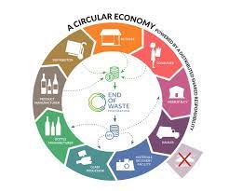
Circular economy: definition, importance and benefits
What is the circular economy?
The circular economy is a model of production and consumption, which involves sharing, leasing, reusing, repairing, refurbishing and recycling existing materials and products as long as possible. In this way, the life cycle of products is extended.
In practice, it implies reducing waste to a minimum. When a product reaches the end of its life, its materials are kept within the economy wherever possible. These can be productively used again and again, thereby creating further value.
This is a departure from the traditional, linear economic model, which is based on a take-make-consume-throw away pattern. This model relies on large quantities of cheap, easily accessible materials and energy.
Also part of this model is planned obsolescence, when a product has been designed to have a limited lifespan to encourage consumers to buy it again. The European Parliament has called for measures to tackle this practice.

Slide 4
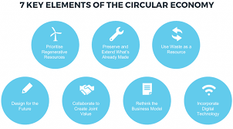
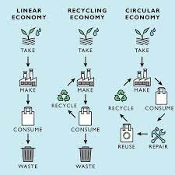
2. Why do we need to switch to a circular economy?
The world's population is growing and with it the demand for raw materials. However, the supply of crucial raw materials is limited.
Finite supplies also means some EU countries are dependent on other countries for their raw materials.
In addition extracting and using raw materials has a major impact on the environment. It also increases energy consumption and CO2 emissions. However, a smarter use of raw materials can lower CO2 emissions.
3. What are the benefits?
Measures such as waste prevention, ecodesign and re-use could save EU companies money while also reducing total annual greenhouse gas emissions. Currently, the production of materials we use every day account for 45% of the CO2 emissions.
Moving towards a more circular economy could deliver benefits such as reducing pressure on the environment, improving the security of the supply of raw materials, increasing competitiveness, stimulating innovation, boosting economic growth (an additional 0.5% of gross domestic product), creating jobs (700,000 jobs in the EU alone by 2030).
Consumers will also be provided with more durable and innovative products that will increase the quality of life and save them money in the long term.

Slide 5
The Seven Pillars of the Circular Economy
The circular economy is a term that has gained a great deal of popularity among both businesses and governments over the last few years. With its growth in usage, the number of ways in which the term is defined have proliferated. Although some consensus is developing among the different players working in the field, there remains a lack of clarity about what “circular” actually means in practice. A great deal of focus in the circular economy field is on the management of materials and ensuring that resource cycles are closed, in a similar way that occurs in natural ecosystems, where water and nutrients are continuously cycled. So we began by taking this principle to its ultimate conclusion: in a circular economy, all materials should be used in such a way that they can be cycled indefinitely, just as they theoretically can in nature.
Thinking through how materials should ideally be handled in a circular economy leads to all kinds of further conclusions regarding material toxicity, the scarcity of certain materials, the persistence of certain materials in the environment, and many other parameters. On this basis, we have developed a set of circularity factors that provide guidelines for the optimal use of materials for different functions. These are metrics that we use to define a material based on its properties such as recyclability, scarcity, toxicity, etc. Using these factors, we have developed shorthand recommendations for how certain materials should be used to uphold circular economy objectives.

Slide 6
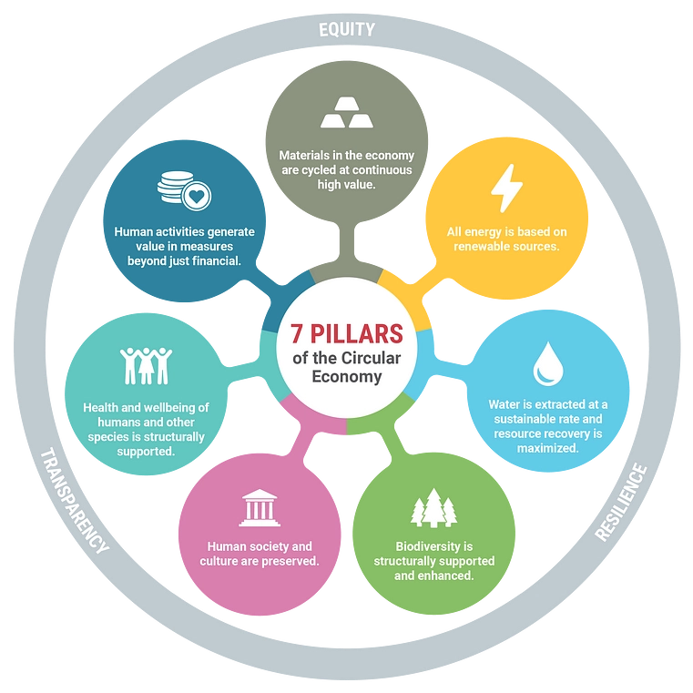

Slide 7
1. Materials are cycled at continuous high value. Material complexity is conserved by cascading materials in their most complex form for as long as possible. Material cycles are designed to be of appropriate lengths for human time scales and the natural cycles to which they are connected. Scarce materials are preferentially cycled at shorter intervals so they can be recovered sooner for reuse. Materials are transported within as small a geographic range as possible. Materials are not mixed in ways which preclude separation and recovery, unless they can continue to cycle infinitely at high value in their mixed form (although this is still not ideal because it limits choice). Materials are used only when necessary: there is an inherent preference for dematerialization of products and services.
2. All energy is based on renewable sources. The materials required for energy generation and storage technologies are designed for recovery into the system. Energy is intelligently preserved and cascaded when lower values of energy are available for use, such as heat cascading. Density of energy consumption is matched to density of local energy availability to avoid structural energetic losses in transport. Conversion between energy types is avoided, as is transportation. The system is designed for maximum energy efficiency without compromising performance and service output of the system.
3. Biodiversity is supported and enhanced through human activity. As one of the core principles of acting within a circular economy is to preserve complexity, preserving biodiversity is a top priority. Habitats, especially rare habitats, are not be encroached upon or structurally damaged through human activities. Preservation of ecological diversity is one of the core sources of resilience for the biosphere. Material and energetic losses are tolerated for the sake of preservation of biodiversity; it is a much higher priority.
4. Water resources are extracted and cycled sustainably. Water is one of our most important shared resources: sufficient quantity and quality of water is essential to our economy and our survival. In a circular economy the value of water is maintained, cycling it for indefinite re-use while simultaneously recovering valuable resources from it whenever possible. Water systems and technologies minimize freshwater usage, and maximize energy and nutrient recovery from wastewater. Watershed protection is prioritized, and harmful emissions to aquatic ecosystems are avoided as a top priority.
4. Human society and culture are preserved. As another form of complexity and diversity (and therefore resilience), human cultures and social cohesion are extremely important to maintain. In a circular economy, processes and organizations make use of appropriate governance and management models, and ensure they reflect the needs of affected stakeholders.
5. Activities that structurally undermine the well-being or existence of unique human cultures are avoided even at high cost.
The health and wellbeing of humans and other species are structurally supported. Toxic and hazardous substances are minimized and kept in highly controlled cycles, and should ultimately be eliminated entirely. Economic activities never threaten human health or well-being in a circular economy. For example, successfully recycling e-waste by having people burn it over open fires is not considered a “circular” activity despite the fact that it results in material recovery.
6. Human activities maximize generation of societal value. Materials and energy are not currently available in infinite measure, so their use should meaningfully contribute to the creation of societal value. Forms of value beyond financial include: aesthetic, emotional, ecological, etc. These cannot be brought down to a common measure without making gross approximations or imposing subjective value judgements; they are, therefore, recognized as value categories in their own right. The choice to use resources maximizes value generation across as many categories as possible rather than simply maximizing financial returns.

Slide 8
First circular economy action plan
New circular economy action plan
The European Commission adopted the new circular economy action plan (CEAP) in March 2020. It is one of the main building blocks of the European Green Deal, Europe’s new agenda for sustainable growth. The EU’s transition to a circular economy will reduce pressure on natural resources and will create sustainable growth and jobs. It is also a prerequisite to achieve the EU’s 2050 climate neutrality target and to halt biodiversity loss.
The new action plan announces initiatives along the entire life cycle of products. It targets how products are designed, promotes circular economy processes, encourages sustainable consumption, and aims to ensure that waste is prevented and the resources used are kept in the EU economy for as long as possible.
It introduces legislative and non-legislative measures targeting areas where action at the EU level brings real added value.
In 2015, the European Commission adopted its first circular economy action plan. It included measures to help stimulate Europe's transition towards a circular economy, boost global competitiveness, foster sustainable economic growth and generate new jobs.
The action plan established concrete and ambitious actions, with measures covering the whole life cycle: from production and consumption to waste management and the market for secondary raw materials and a revised legislative proposal on waste.

Slide 9
How is a circular economy different from a linear economy?
A circular economy is fundamentally different from a linear economy. To put it simply, in a linear economy we mine raw materials that we process into a product that is thrown away after use. In a circular economy, we close the cycles of all these raw materials. Closing these cycles requires much more than just recycling. It changes the way in which value is created and preserved, how production is made more sustainable and which business models are used.
From new raw materials to value preservation
The circular system and the linear system differ from each other in the way in which value is created or maintained. A linear economy traditionally follows the “take-make-dispose” step-by-step plan. This means that raw materials are collected, then transformed into products that are used until they are finally discarded as waste. Value is created in this economic system by producing and selling as many products as possible.

Slide 10
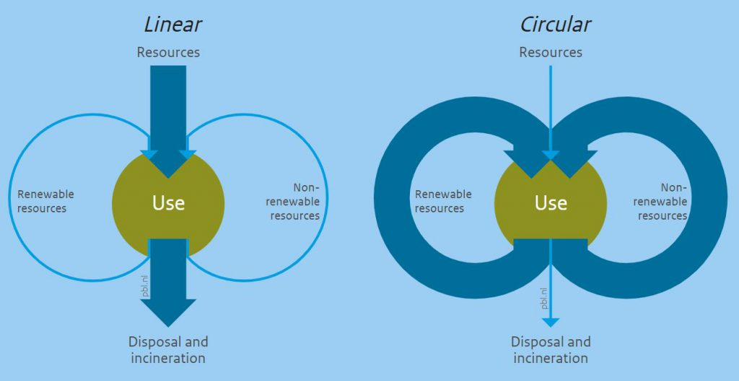

Slide 11
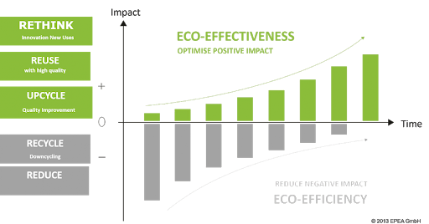

Slide 12
The difference between a linear and a circular economy
 | Linear | Circular
Step plan | Take-make-dispose | Reduce-reuse-recycle
Focus | Eco-Efficiency | Eco-Effectivity
System boundaries | Short term, from purchase to sales | Long term, multiple life cycles
Reuse | Downcycling | Upcycling, cascading and high grade recycling.

Slide 13
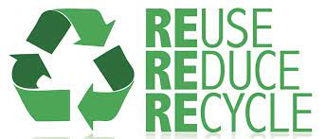
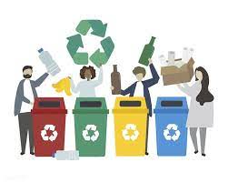
The difference between a linear and a circular economy
In recent years, the European Commission has tried to promote the transition to a circular economy with the Circular Economy Action Plan. An important reason for this is that the transition could bring the European Union 7% extra economic growth in 2030 and 170,000 new jobs in 2035. In addition, the transition will substantially reduce the ecological footprint. Nevertheless, the European Commission itself states that a lot of policy is still needed to achieve all the benefits of a circular economy.

Slide 14
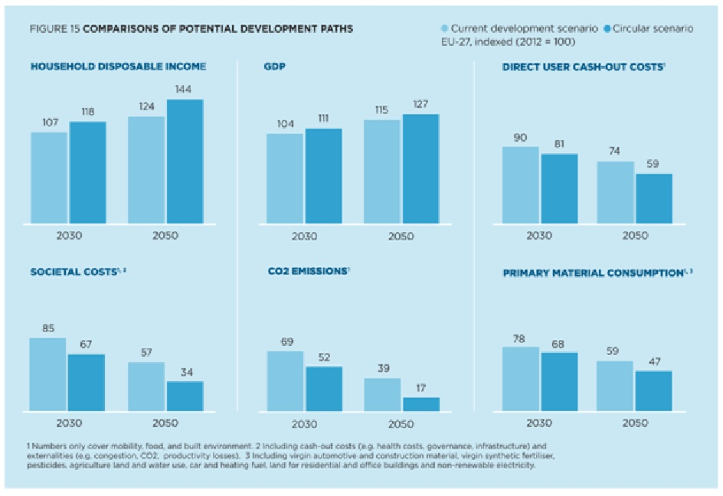

Slide 15
Future
The European Commission itself states on the follow-up to the Circular Economy Action Plan that if the European Union wants to maintain its leadership role in the design and production of circular products and services, circularity must become the backbone of the industrial strategy. For example, circularity must be introduced in new areas and sectors, life cycle assessments of products must become the norm and the framework for eco-design must be broadened as much as possible (European Commission, 2019). Eco-design looks at the whole life cycle of a product or process and addresses the highest environmental impacts first.

Slide 16
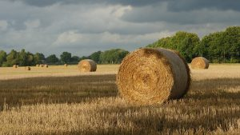
How do we use biomass and food circularly?
Biomass plays a special role in the circular economy because it is fully recyclable and used as food, fuel and material. Closing biomass flows in the agri-food sector would make the Dutch living environment healthier and save the economy €6.5 billion a year in costs. So there are many opportunities for farmers, processors, retailers and other entrepreneurs who focus on circularity.
Biomass is a container term for raw materials of vegetable and animal origin. This includes crops from agriculture, water cultivation (such as algae) and forestry, as well as their residual flows in the chain of harvesting, consumption and final processing. Bioplastics and biofuels can be produced from biomass, but these themselves are not included in the definition. This article discusses the opportunities and barriers to closing biomass flows in the Netherlands, with an emphasis on the food chain.

Slide 17
The opportunities
Many companies earn by closing cycles. Strategies for circularity can be used along the entire food chain, from the farmer to the plate and beyond. There are three strategies that many entrepreneurs focus on:
Closing material cycles in companies, so that waste and purchasing costs are reduced;
Collecting waste streams, so that different fractions can be used separately and the whole increases in value;
Adding value to waste streams, such as by the creation of new products.
Below are four examples of earning models in the food chain and biomass processing.

Slide 18
On-farm recycling
An example at the beginning of the food chain is the farm Eytemaheert van Maurits and Jessica Tepper. These dairy farmers have closed the largest flows of raw materials on their farms by feeding their cows with grass from their own meadows and nature reserves. They then keep this land fertile with the manure from the same cows. They do not use concentrates, so milk production is lower, but the quality is higher. The big advantage is that Maurits and Jessica save costs, because they do not buy cattle feed and/or manure. In addition, the emissions of nitrogen and greenhouse gases are significantly lower on their farms. The reason that not all milk is produced in the Netherlands in this way is because most dairy farmers do not have enough land available to farm.
Valuable residual flows from retail
A company that applies circularity to food processing is De Clique. This company collects food that restaurants and company caterers can no longer sell. De Clique then processes these residual flows into products such as essential oils and the breeding ground for oyster mushrooms. Residues still contain many valuable raw materials. The reason that not all residual flows are processed into new products is because the logistics for these types of flows still have to be developed and legislation often imposes many requirements on raw materials. Companies that find solutions to these barriers can unlock the value of these raw materials.

Slide 19
Circular fashion is sustainable fashion
The fashion industry can become sustainable, reduce emissions and cut waste by adopting the circular economy model.

Slide 20
What is circular fashion and what are its benefits?
Circular fashion is designed and manufactured based on a model of sustainable production and consumption in which materials and products are recovered, recycled and reused, cutting waste and emissions. This is important because worldwide, the fashion industry generates about 20 million tons of waste each year and accounts for over 10% of global GHGs. This makes it the biggest single source of emissions in the world, according to The State of Fashion 2021, a joint report by McKinsey & Company and The Business of Fashion (BoF).
The future of circular fashion
The clothing and textile industry is the second largest polluter in the world, behind big oil. But it doesn't have to be this way. Circularity in fashion is a viable alternative to replace the take-make-waste model with a recover-recycle-reuse model. This generates added value, because it turns waste into materials that can be reinjected into the value chain. Companies across many industrial sectors are adopting circular economy principles, including Enel X. As a part of this commitment, Enel X and its partners have launched the Monitor for Circular Fashion to promote a sustainable production and consumption model in the clothing industry. The fashion world can be a trend-setter not just on the catwalks, but in the fight against climate change too.

Slide 21
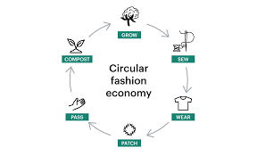
A circular fashion industry is defined as a regenerative system in which garments are circulated for as long as their maximum value is retained, and then returned safely to the biosphere when they are no longer of use.In a circular model, products are designed and developed with the next use in mind. Less than 1% of clothing is recycled into new clothing. The best thing we can do is buy less and reuse more. If everyone bought just one used item instead of new this year, it would have a huge collective and positive impact on the planet.

Slide 22
THE VISION OF A NEW TEXTILES ECONOMY
Creating business models which are restorative and regenerative.
The overarching vision of a new textiles economy is that it aligns with the principles of a circular economy: one that is restorative and regenerative by design and provides benefits for business, society, and the environment. In such a system, clothes, textiles, and fibres are kept at their highest value during use and re-enter the economy after use, never ending up as waste. A new textiles economy is an attractive vision of a system that works
Realising this vision of a new global textiles system relies on three focus areas:
New business models that increase clothing use
Safe and renewable inputs
Solutions so used clothes are turned into new

Slide 23
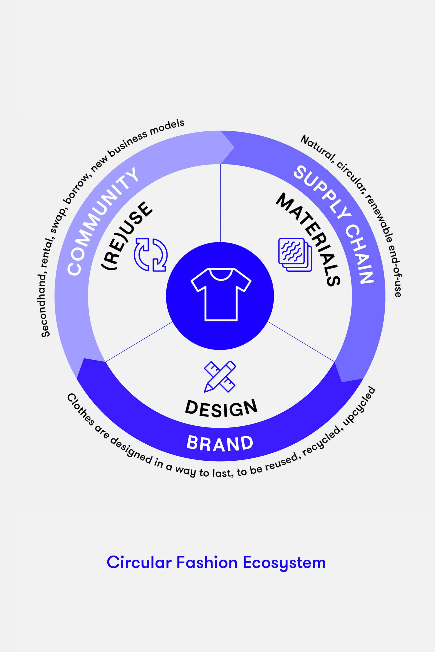
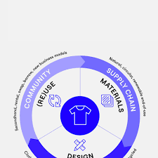

Slide 24
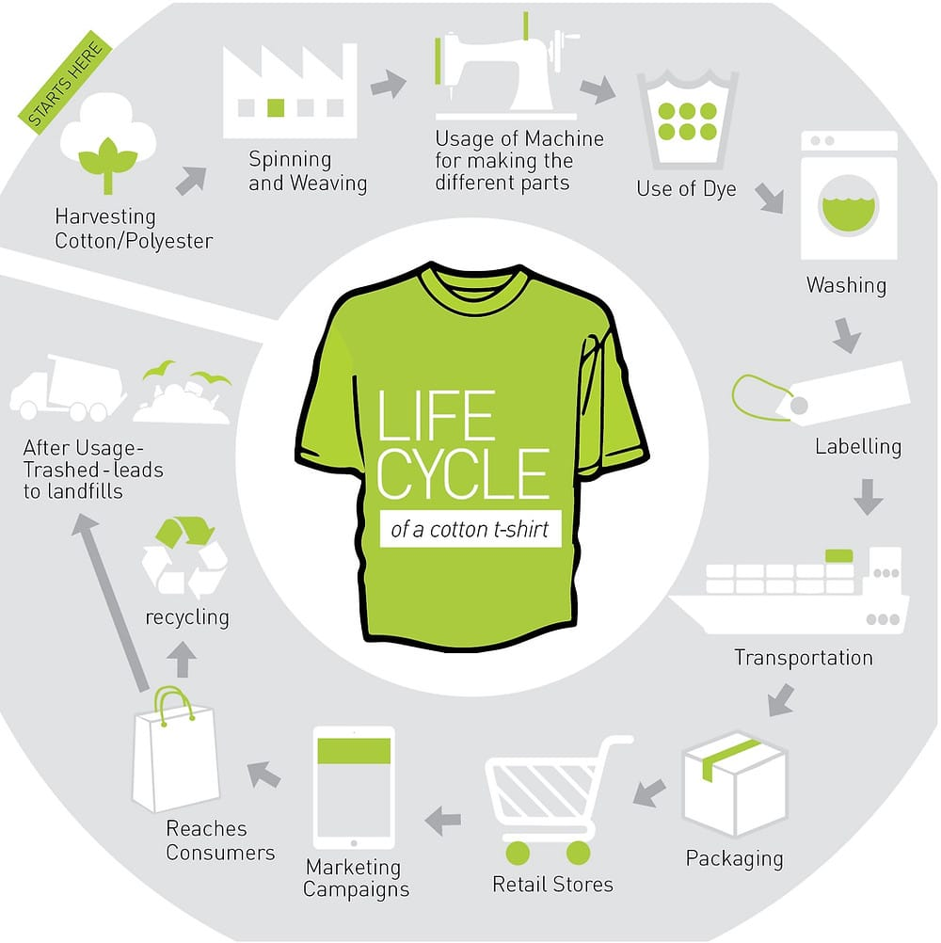

Slide 25
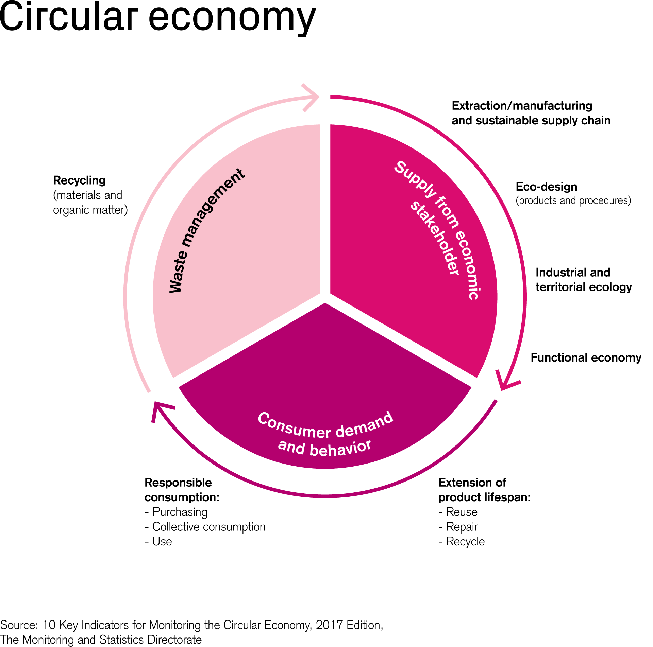
MAKE RESALE ATTRACTIVE TO A WIDE RANGE OF CUSTOMERS
Designing clothes to last and creating innovative resale models.
As the average quality and durability of clothing on the market increases, so will the opportunity of capturing its value through new business models. Clothing resale is already widely adopted across the world. The latest figures from the ThredUp Resale report 2019 show that resale has grown 21 times faster than retail over the past five years. In fact, 56 million women bought second-hand products in 2018, up from 44 million in 2017. Therefore, if clothes are increasingly made to last, introducing attractive resale models suited to a wider customer base locally (i.e. in the same countries where clothes are being discarded) could significantly increase clothing utilisation. To achieve this, innovative resale models, partnerships, and the harnessing of digital technology are all required. Stella McCartney’s ongoing partnership with the Real Real and the Reformation partnership with ThredUp are examples of successful collaborations.

Slide 26
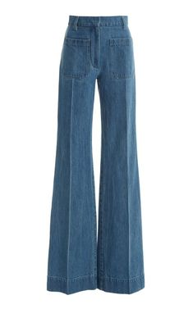
Organic jeans for rent: MUD Jeans
MUD is a fashion brand that turns the traditional fashion model on its head. Instead of buying and selling clothes, it lets customers rent them and then recycle them.
One of the most damaging aspects of fashion is the use of toxic chemicals in the production of clothes. A pair of jeans uses up to 7,000 liters of water annually.These clothes are among the most wasteful items that we make.
They use up about 7,000 liters of water and are regularly dyed with toxic chemicals.
MUD makes, rents and recycles organic cotton jeans.
"If you love jeans as much as this planet you’re in a good place here"

Slide 27
A new business model and innovative manufacturing techniques
MUD lease jeans made from 40% recycled denim and 60% organic cotton for a monthly fee. Free repairs are included during the leasing period.
After leasing for a year, you have three options:
Swap your jeans for a new pair and continue leasing for another year.
Keep the jeans and wear them for as long as you like - you can send them back at any time for recycling.
End the relationship and send the jeans to MUD to get a voucher for a new purchase.

Slide 28
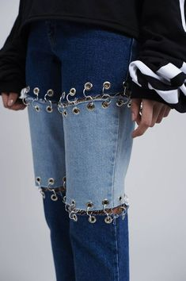
How MUD jeans are made
MUD reduces their impact by using new techniques. They:
save water by using a rainwater-only factory where 95% of water is recycled
create a desirable worn effect by using lasers instead of potassium permanganate
get a stonewash effect by using abrasive parts inside washing machines rather than polluting pumice stones
work with suppliers who are energy self-sufficient
get a bleach-wash effect using oxygen converted into ozone - afterwards, the ozone is turned back to oxygen

Slide 29
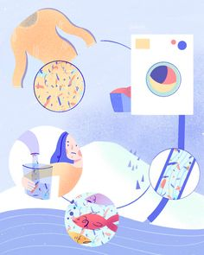
The Romanian circular fashion startup that aims to change the way women do shopping
Garderoba Infinita, or the Infinity Wardrobe, is an activist project that targets women who buy clothes that they don’t wear and practice swapping items with their friends. Fashion consumerism has led the population to buy fast and wear only 20% of their clothes. In 2018, the brand seized the opportunity to develop a circular fashion startup, where pieces are resold or lent to buyers who aren’t looking to contribute to traditional fashion.

Slide 30
‘’ ‘Circular fashion’ can be defined as clothes, shoes or accessories that are designed, sourced, produced and provided with the intention to be used and circulate responsibly and effectively in society for as long as possible in their most valuable form, and hereafter return safely to the biosphere when no longer of human use.” Anna Brismar coined the term back in 2014.
Two entrepreneurs, Adriana Ancuta and Andreea Cartu co-founded the circular fashion startup Garderoba Infinita in Bucharest, Romania, in 2018. This step came after collaborating on other new media and fashion-related projects a decade before the launch of the conscious fashion startup. They didn’t rush into the project; they researched and Adriana Ancuta was part of the Impact Startup Factory.
“Any startup is playing against the odds. You know from the start that only 1 out of 10 startups will survive in the long run. With that in mind we tried from the very first day to maximize our chances, with our first investment received in the very early stage of our startup from an angel investor,” states Adriana Ancuta, co-founder of Garderoba Infinita.

Slide 31
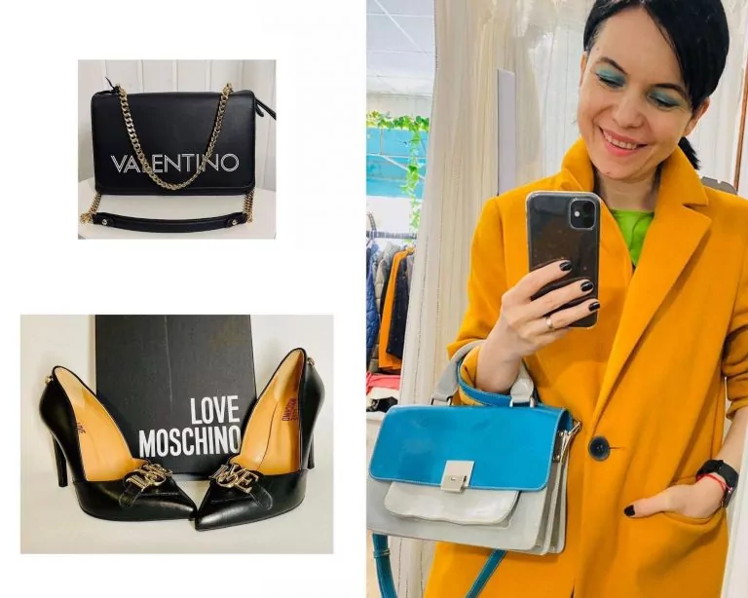
How does Garderoba Infinita work?
Clients send over photos of the pieces and the first phase of approval begins. When the products are sent over at the headquarter, the team curates everything. After the second phase, an affordable price is established and everything is uploaded online.
Then, the circular economy cycle begins.
Adriana Ancuta, Garderoba Infinita co-founder
“We are happy that our community is increasing organically, meaning that we are in the right place at the right moment. Do we save the planet? No. Do we make a change regarding the way women do shopping towards responsible and circular consumption? Totally YES. And that provides us enough energy to keep ourselves on the journey,” shares Adriana.

Slide 32
Garderoba Infinita – from 2018 to 2021
Garderoba Infinita began online with pieces from the founder’s wardrobe. These were auctioned with the help of the Instagram community. During the last three years, the startup’s fee was 35% of the price established with the seller, but the rule was that it wouldn’t go beyond 10 euros per piece.
Garderoba Infinita has put into the eCommerce circuit over 4500 outlet products. More than 350 vendors opened their passive wardrobe and shared pre-owned brand pieces with labels or worn once. The team has brought in collaborators from the Romanian designers’ market for an exchange of awareness.
In 2019 Garderoba Infinita had a turnover of 100.000 euros. With the aid of their first finance opportunity, the project moved forward developing offline. The startup was increasing its revenue 6 times, they were ready for a new investment round that would move the project nationally, but the pandemic made the consignment process impossible.
“Startups are capable of bootstrapping in their third year, but in my opinion, they only have to accept slower pace growth. Instead of focusing on exponential growth, the priorities are now sustainability of the business model and profitability. We still keep in mind the scaling plans but we will do it most probably with our own resources, even if that will imply more time.” tells Adriana to The Recursive.

Slide 33
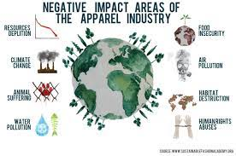
Comparison between the two businesses
Mud jeans are a new business model that is based on saving resources. To make a pair of jeans, which you probably wear for a maximum of one season, you need too many materials. Mud Jeans aims to save water, using rainwater. He preferred to use modern technology, laser, instead of potassium permanganate.
Infinite wardrobe is a project that aims to extend the life of a clothing item. Adrina Ancuta, co-founder, unlike the Mud Jeans team, started the idea online, later trying to open a physical shop, an idea that did not want much success due to the pandemic. More specifically, Infinite Wardrobe, is a program through which people, instead of throwing a coat or an accessory, photograph it and send it to the wardrobe. They put a low price on it and sell it on. You can often find clothing items from the big fashion houses (Gucci, Balenciaga, Louis Vuitton) even at half price.

Slide 34
CONCLUSION
It's no secret that fashion hasn't always been the most eco-friendly industry. In fact, the fashion industry accounts for 2% of global Gross Domestic Product, or GDP, and is also now considered one of the largest polluters in the world but to inspire change and push for the future of sustainable fashion, more than 3,080 facilities worldwide were certified to Global Organic Textile Standard, or GOTS, in 2013, and the numbers are growing. One of the key criteria for a textile product to carry the GOTS "organic" label is that it must contain at least 95% certified organic fibers.
While international organizations, governments and businesses work on solutions to shift the fashion industry toward a more sustainable pathway, consumers can also play a role with their daily actions. This section provides resources on the actions individuals can take to support sustainability in their apparel choices.

Slide 35
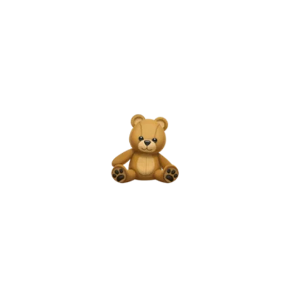
BIBLIOGRAPHY
https://www.symbaloo.com/home/mix/13eOhLFQXX
THANK YOU FOR YOUR ATTENTION!!!!

